Slide 1



Optimal Control and Pesticides
Stuart Johnson
Stanford AA203
Optimal and Learning-based Control

Slide 2
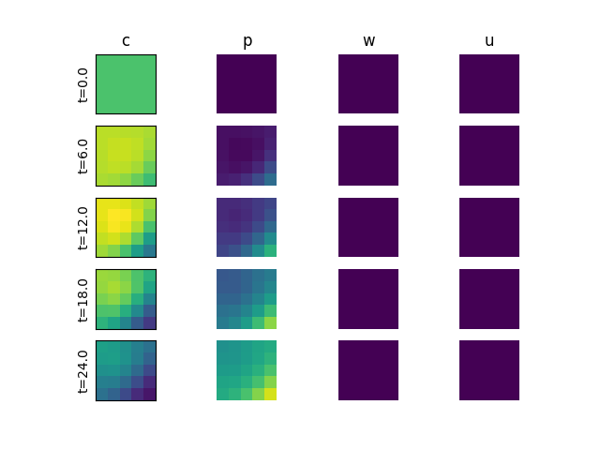
No control. Pests. From the SE.
Crop density
Pest density
Pesticide density
Pesticide
spray rate
time

Slide 3
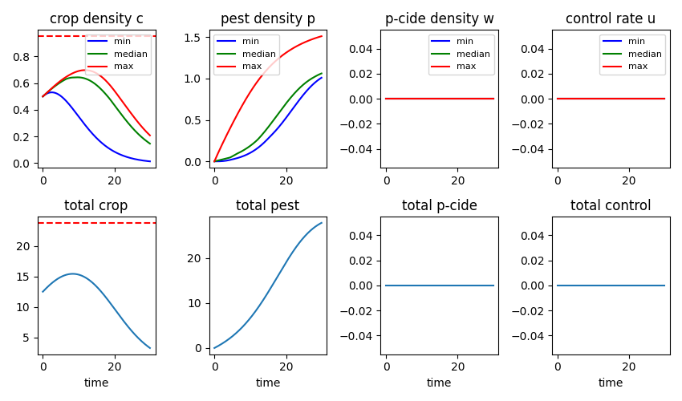
No control. Pests. From the SE.

Slide 4
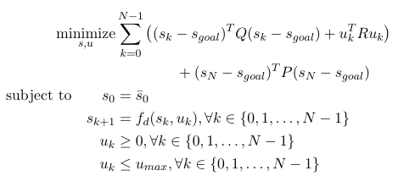
Optimal Control: time and space
Growing season / Harvest time goal state
Optimal
Control Problem
Control Scenarios
SCP JAX/CVXPY
2D x Time optimal control
Reaction-Diffusion Crop/Pest
Dynamics

Slide 5
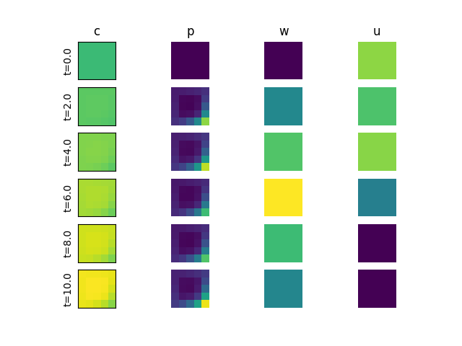
Control scenario: Aerial spraying
Crop density
Pest density
Pesticide density
Pesticide
spray rate
time

Slide 6
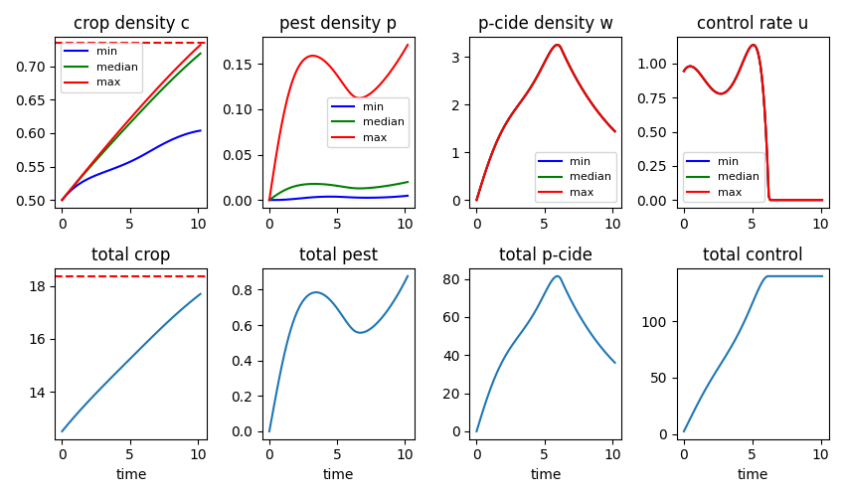
Control scenario: Aerial spraying

Slide 7
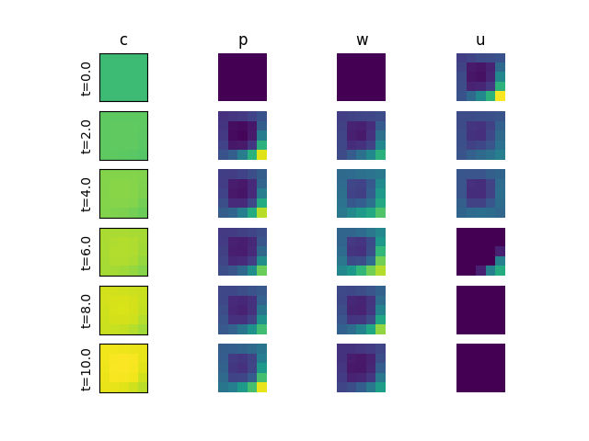
Control scenario: Spot spraying
Crop density
Pest density
Pesticide density
Pesticide spray rate
time

Slide 8
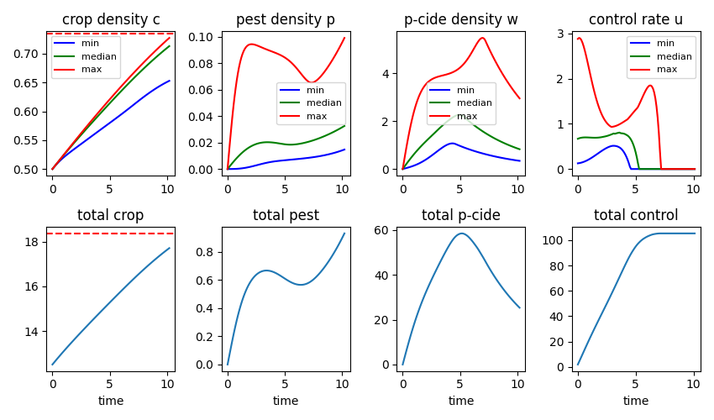
Control scenario: Aerial spraying

Slide 9
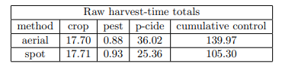
Aerial vs spot spraying
25% reduction
Results are strongly dependent on many parameters of the problem

